Slide 1
Sprint A 2NA – Group 1
Group Members:
Diogo Sousa (1222132)
Filipe Teixeira (1171159)
Henrique Silva ( 1171311)
João Silva (1960184)
Simão Gomes (1050347)

Slide 2
Sprint Planning – Sprint A
Start Date: 22/02/2023 End Date: 16/04/2023
SPRINT BACKLOG
Number of stories | 6
Number of bugs | 0
Number of tasks | 0
Number of Management Tasks | 0
Number of team members | Planned: 4 Actual: 5

Slide 3
Sprint Backlog – Sprint A
SPRINT BACKLOG
US 001 | As Project Manager, I want the team to follow the technical constraints and concerns of the project
US 002 | As Project Manager, I want the team to elaborate a Domain Model using DDD.
US 003 | As Project Manager, I want the team to use the defined project repository and continuous integration server.
US 004 | As Project Manager, I want the team to add to the project the necessary scripts, so that build/executions/deployments/... can be executed effortlessly.
US 005 | As Project Manager, I want the team to configure the project structure to facilitate / accelerate the development of upcoming user stories.
US 006 | As a Project Managers, I want the system to support and apply authentication and authorization for all its users and functionalities.

Slide 4
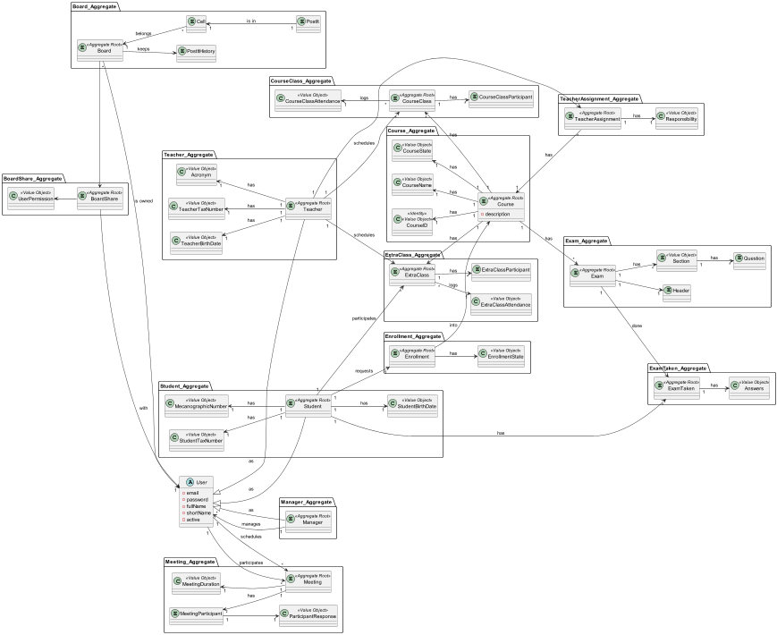
Sprint Review
Date: 15/04/2023
Demonstration:

Slide 5
Sprint Review
Date: 15/04/2023
Main conclusions:
The work should have started earlier and with a more uniform pace in order to clear doubts and properly solve them on the respective task.
The team should have a better “know-how” of the technical aspects and challenges from the problems that each tasks presented to be solved.

Slide 6
Sprint Retrospective
Date: 15/04/2023
What went well?
Good interaction with Github
Good team spirit
Good team-work
What went wrong?
Late resolution of the issues
Lack of time to complete all tasks
No time to study the technical aspects
Late task review
Lack of organization
What we’ve learned?
The team members should have a stricter time-management
The work should start from the beginning
Team should allocate time to study the technical aspects involving an issue
The review of each task should happen earlier to avoid errors
We must have a more organized organization / time management between tasks

Slide 7
Sprint Retrospective
Date: 15/04/2023
Action items:
Earlier definition of the issues
Earlier attribution of the issues
Earlier definition of the tasks of each issue
More interaction between students/teachers to have more support
Create a routine for each day to study and develop some code for the pending issues

